Slide 1
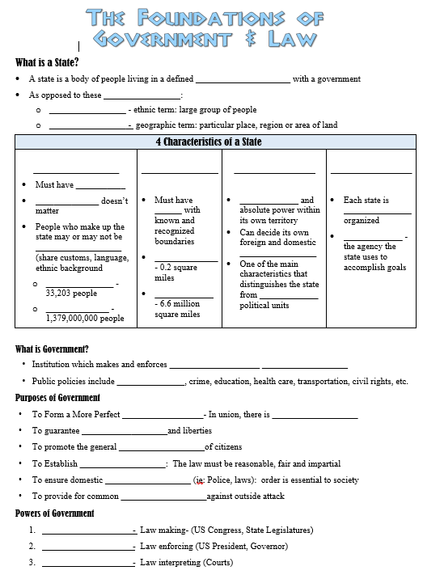

Thank you!
Thank you so much for purchasing this product for your classroom! I very much appreciate your support and business. Please, however, do not post this resource to any webpage, blog, Weebly page or Youtube. This is a violation of our Terms of Use.
Guided Outline Notes https://docs.google.com/document/d/1dBSrDuJnBJobaysLVBO1fWS6gS69De9VhdPIiJDrwYI/edit?usp=sharing
Google Slides Version:
https://docs.google.com/presentation/d/1WVBjPfwsystpcj44X7cR1BC8O0-rqdAa7sT-lLMjrmw/copy
Flipped Classroom Video:
https://youtu.be/TCeQB4xZBuI
A good warm up is to have students write down everything they did so far today. No detail is too small and stress for them to include as much as possible. Then, ask a few students to share. Tell students that we're going to talk about the purpose of government today briefly discuss what a "state" is. Then, ask them to put a star next to everything they listed that the government is involved in. You can then discuss how almost everything we do somehow involves the government (food regulation, transportation & traffic laws, school, taxes on the clothes they purchased, etc.).
Notes:
© Students of History - https://www.teacherspayteachers.com/Store/Students-Of-History

Slide 2
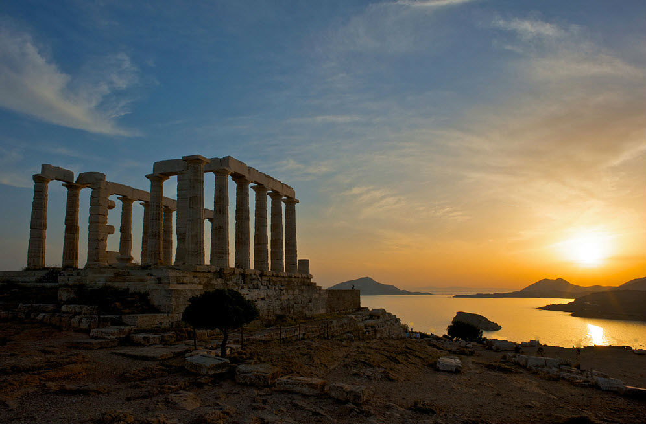
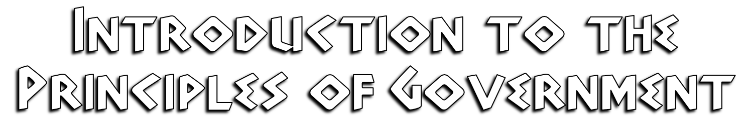

Slide 3
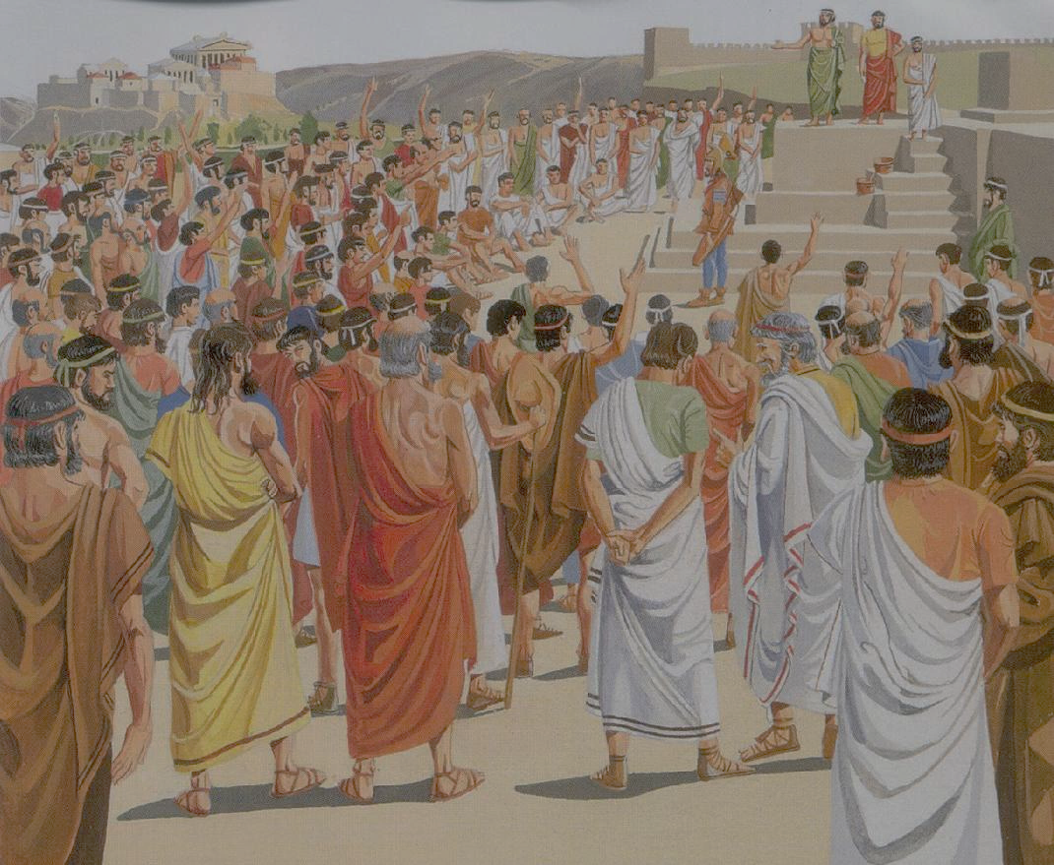

A state is a body of people living in a defined territory with a government
As opposed to these terms:
Nation- ethnic term: large group of people
Country- geographic term: particular place, region or area of land
Notes:
In political science, the term "state" refers to a political entity that exercises sovereignty over a defined territory and its population. A state possesses the authority to make and enforce laws, maintain order, collect taxes, and engage in international relations. It is characterized by a centralized government with a set of institutions and administrative structures. On the other hand, "nation" refers to a community of people who share a common culture, language, history, or ethnicity. A nation may or may not have its own state. A "country," often used interchangeably with "state," generally refers to a geographical region that has recognized borders and a distinct political and legal system. While the concepts of state, nation, and country are related, they can exist independently of each other, with some nations not having their own state or country and some states comprising multiple nations or countries within their borders

Slide 4
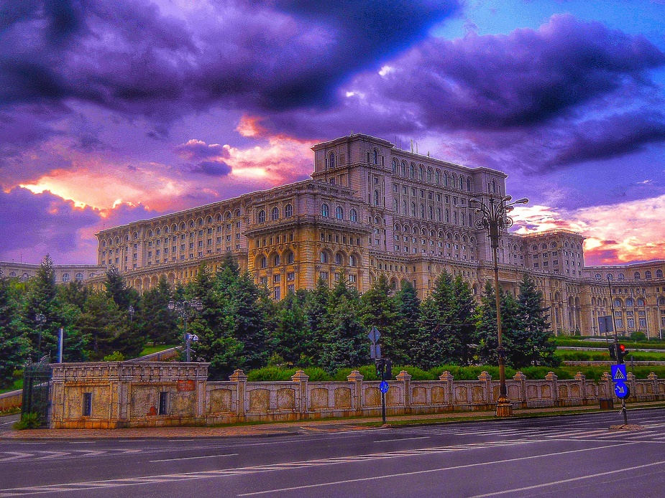
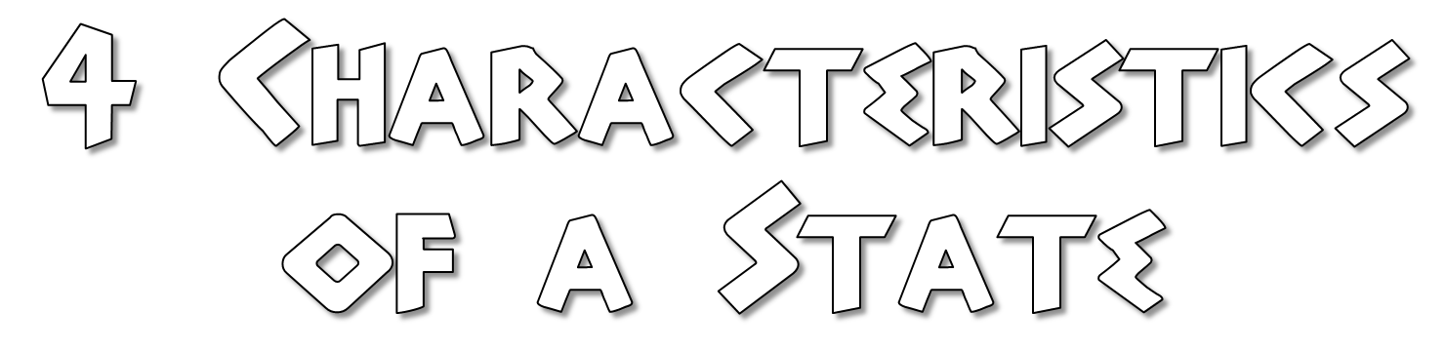
Notes:
Photo: The Palace of the Parliament of Romania in central Bucharest.

Slide 5

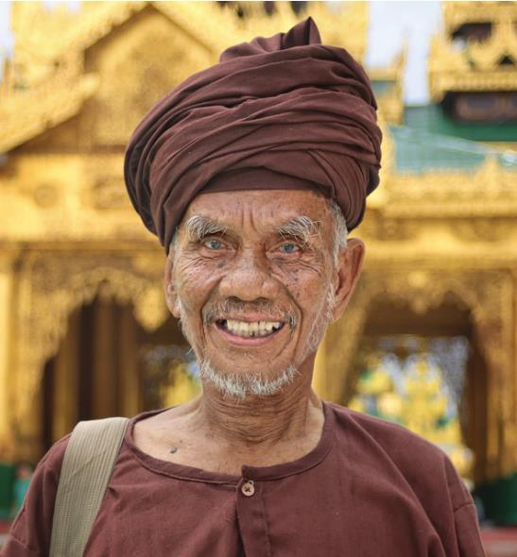
Must have people
Size doesn’t matter
People who make up the state may or may not be homogeneous (share customs, language, ethnic background
San Marino- 33,203 people
China- 1,379,000,000 people
Notes:
In the context of a state, "people" collectively constitute the population that inhabits a given territory and falls under the authority of the state's governance. While a state typically comprises diverse individuals with varying cultural, ethnic, religious, and linguistic backgrounds, it does not necessitate homogeneity among its people. Modern states often embrace and accommodate diversity, recognizing and protecting the rights and identities of different groups within their borders. Inclusive states recognize the importance of pluralism and provide mechanisms for diverse communities to coexist and participate in the political, social, and economic life of the nation. By valuing diversity and promoting equality, states can foster social cohesion and harness the collective potential of their diverse citizenry.

Slide 6


Must have land with known and recognized boundaries
Vatican City- 0.2 square miles
Russia- 6.6 million square miles
Notes:
In political science, the concept of territory is a fundamental element of a state. Territory refers to a specific geographical area over which a state exercises its authority and within which its laws and regulations apply. The notion of territory provides a physical and spatial dimension to the state, delineating its borders and establishing the extent of its jurisdiction. Territory not only defines the geographical limits of a state but also encompasses the land, water, and airspace under its control. It serves as the basis for the state's sovereignty, allowing it to govern its population, establish institutions, enforce laws, and engage in international relations. Without a defined territory, a political entity cannot be considered a state in the traditional sense, as territory is a crucial element that distinguishes a state from other forms of political organization.
Picture is of the tiny village of Xingping in western China.

Slide 7

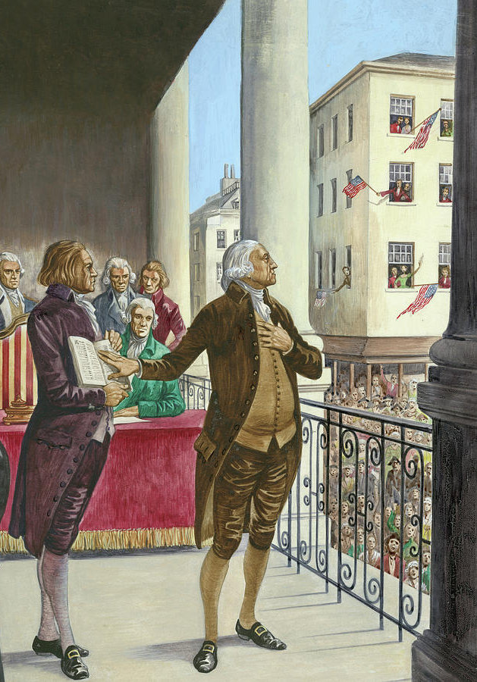
Supreme and absolute power within its own territory
Can decide its own foreign and domestic policies
One of the main characteristics that distinguishes the state from smaller political units
Notes:
In political science, sovereignty is a key attribute of a state. It refers to the supreme authority and control that a state possesses over its own territory, free from external interference. Sovereignty entails the state's ability to make independent decisions, enact laws, and enforce them within its borders. A sovereign state exercises exclusive jurisdiction over its territory, including the power to govern its population, collect taxes, maintain order, and engage in international relations. The principle of sovereignty establishes the state's autonomy and independence, granting it the authority to represent itself in global affairs and negotiate with other states as equals. Without sovereignty, a political entity would be subject to external domination or interference, undermining its status as a fully recognized state.

Slide 8

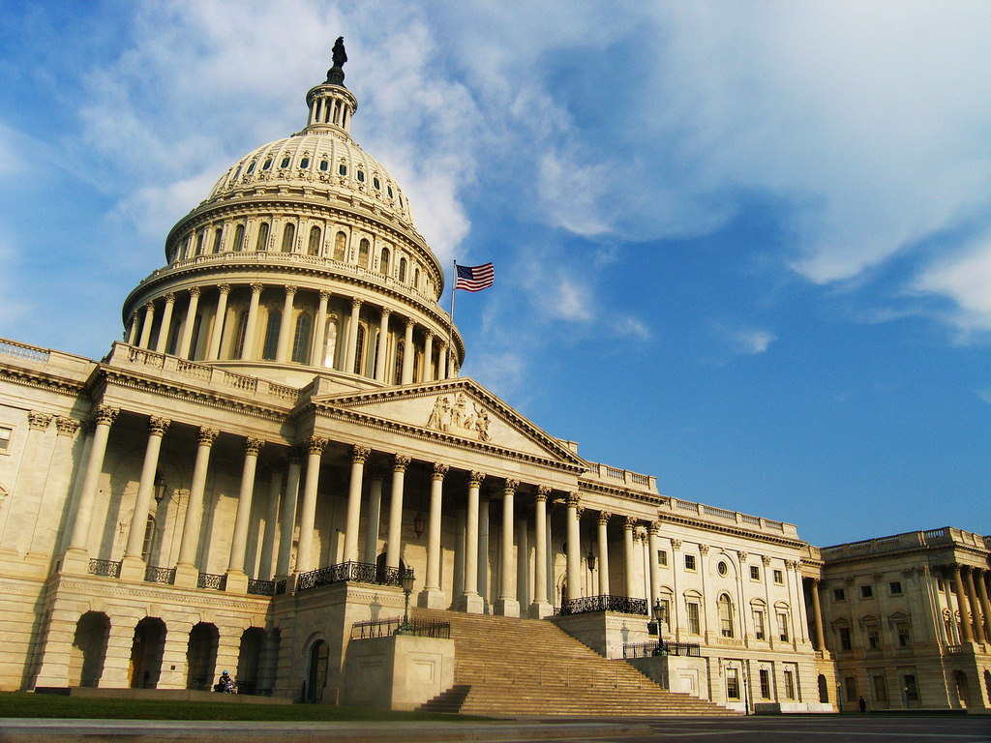
Each state is politically organized
Government - the agency the state uses to accomplish goals

Slide 9
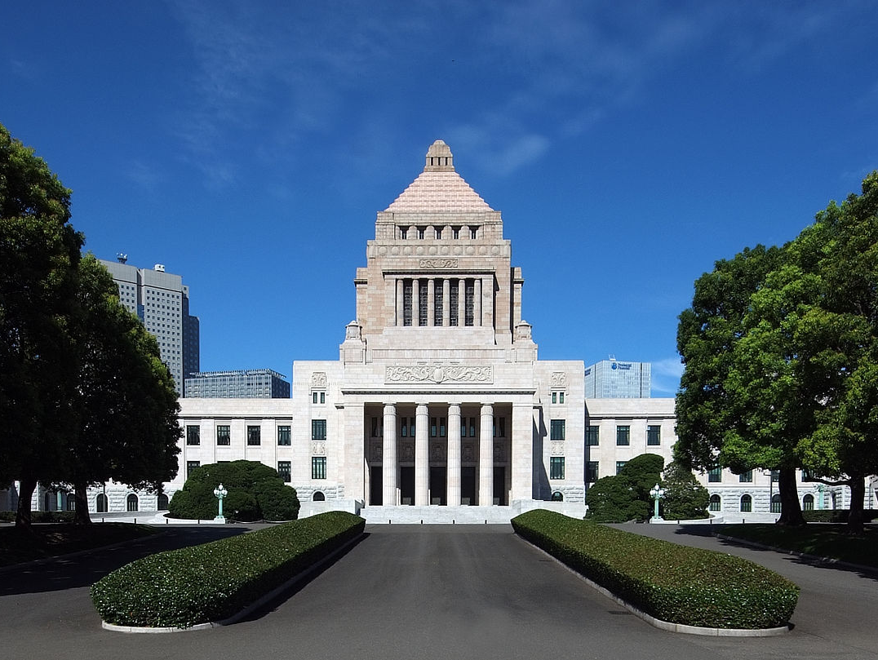

Institution which makes and enforces public policies
Public policies include defense, crime, education, health care, transportation, civil rights, etc.
Notes:
A government is an essential component of a state. It refers to the set of institutions and individuals responsible for making and implementing decisions on behalf of the state and its citizens. A government is responsible for formulating and enforcing laws, maintaining order, providing public services, and representing the state both domestically and internationally. It exercises political authority and wields power through various branches, such as the executive, legislative, and judicial branches. The government plays a vital role in setting public policies, managing resources, and ensuring the well-being of its citizens. It provides the framework for governance, enabling the state to function effectively and fulfill its responsibilities towards its population. Without a government, a state would lack the necessary structures and mechanisms to exercise authority, resulting in an absence of governance and a breakdown of essential functions.

Slide 10
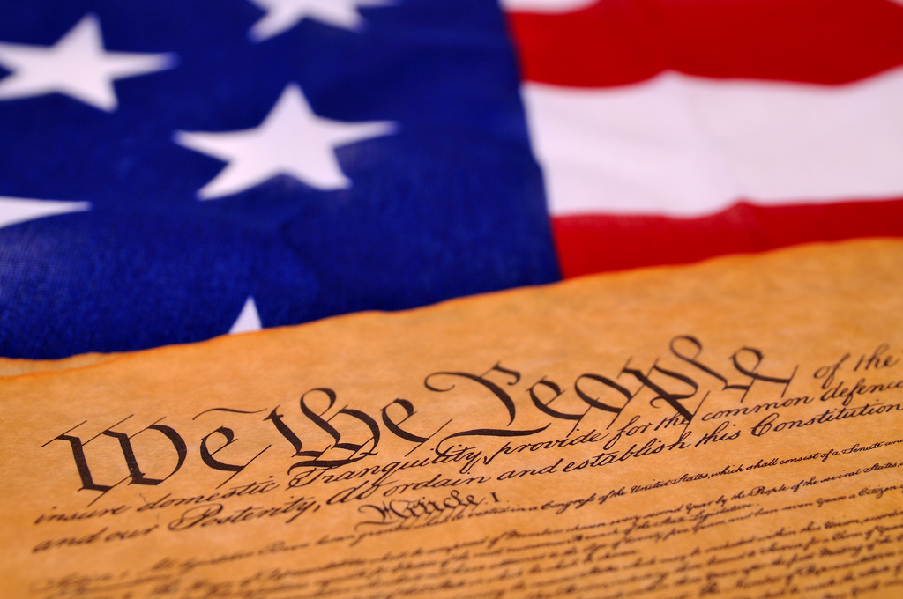
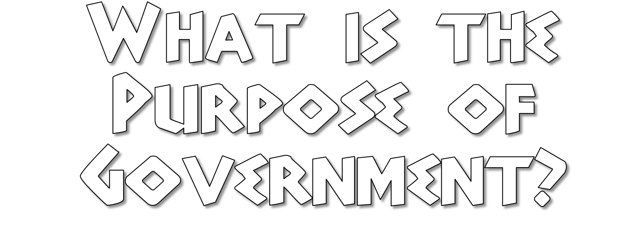
Notes:
The purpose of government is a central concept in political science that seeks to understand the role and function of governing institutions. In an introductory political science course, the purpose of government is typically explored as the framework through which a society establishes order, resolves conflicts, and promotes the well-being of its citizens. Government serves several essential purposes, including maintaining law and order, protecting individual rights, providing public goods and services, managing the economy, and representing the interests of the people on both national and international levels. It is through the government that societies make collective decisions, enforce laws, allocate resources, and address social, economic, and political challenges. By examining the purpose of government, students gain insights into the different forms of governance and the complex dynamics between rulers and the ruled in shaping the functioning and direction of a society.

Slide 11
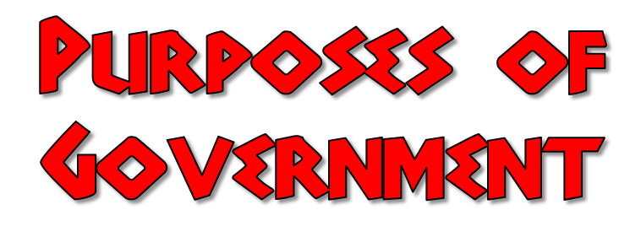
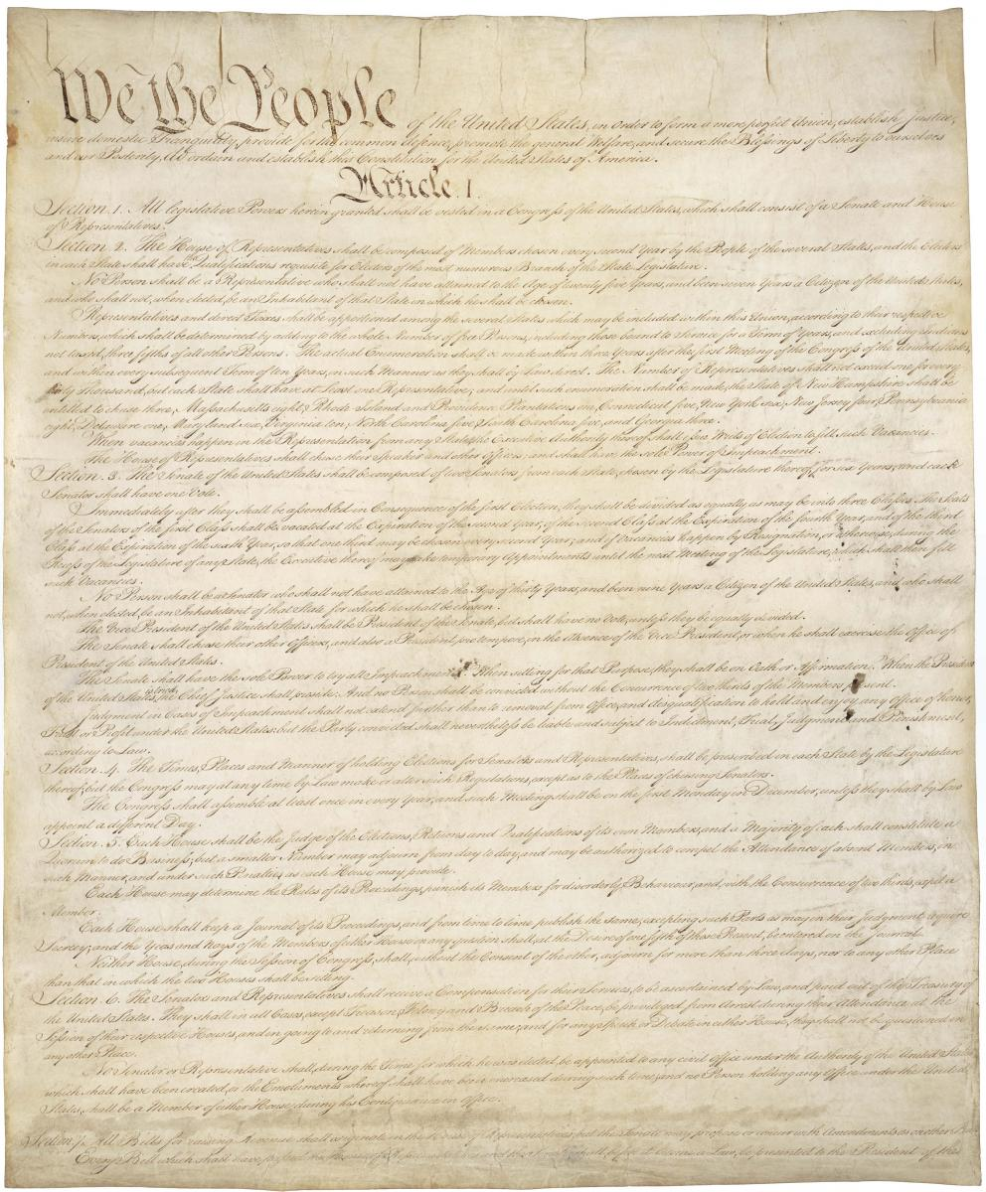
To Form a More Perfect Union- In union, there is strength
To guarantee civil rights and liberties
To promote the general welfare of citizens
To Establish Justice: The law must be reasonable, fair and impartial
To ensure domestic tranquility (ie: Police, laws): order is essential to society
To provide for common defense against outside attack
Notes:
The Preamble to the Constitution is the introductory statement that outlines the fundamental purposes and principles of a constitution. In the case of the Constitution, the Preamble begins with the iconic words, "We the People." It serves as a concise expression of the aspirations and objectives of the framers and establishes the foundation for the subsequent articles and provisions. The Preamble states that its purpose is to form a more perfect union, establish justice, ensure domestic tranquility, provide for the common defense, promote the general welfare, and secure the blessings of liberty. It conveys the intent of the Constitution to create a unified and just society that protects the rights and well-being of its citizens. The Preamble signifies the people's collective commitment to a government that safeguards their freedoms, maintains order, and pursues the common good. It reflects the democratic principles of popular sovereignty and the idea that the power of the government originates from and belongs to the people.

Slide 12
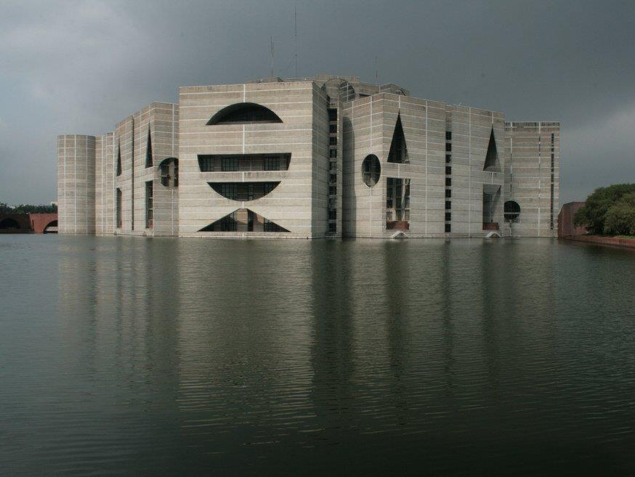

Legislative- Law making- (US Congress, State Legislatures)
Executive- Law enforcing (US President, Governor)
Judicial- Law interpreting (Courts)
Notes:
Governments typically possess three branches that exercise distinct powers: legislative, executive, and judicial. The legislative branch is responsible for making laws and is usually composed of a parliament, congress, or similar body. It enacts legislation, debates policies, and represents the interests of the people. The executive branch, headed by the president, prime minister, or a similar position, implements and enforces laws. It holds administrative and executive powers, overseeing government agencies, making decisions, and managing the day-to-day affairs of the state. The judicial branch comprises the courts and is responsible for interpreting laws and ensuring their application. It adjudicates disputes, upholds the rule of law, and protects individual rights. By dividing powers across these branches, governments establish a system of checks and balances, preventing concentration of power and ensuring accountability. This separation of powers is a fundamental principle of modern democratic governance, promoting fairness, stability, and the protection of individual liberties.
Photo: Jatiya Sangsad Bhaban or National Parliament House, the house of the Parliament of Bangladesh.

